Slide 1
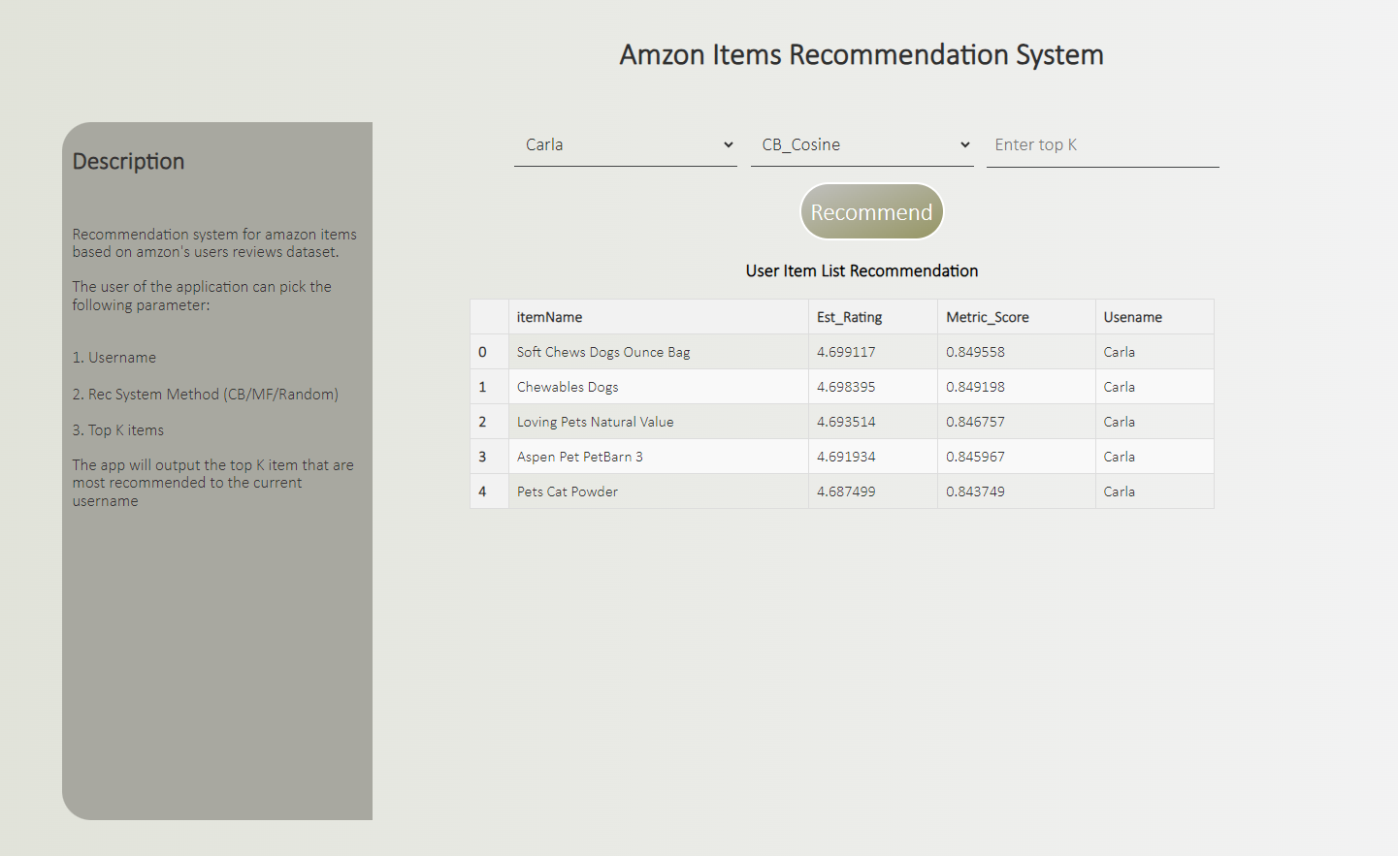
Product Rating Prediction
Rami Fisher

Slide 2

Agenda
Amazon reviews dataset
Recommendation Systems (Challenges)
Data Preprocessing
EDA
Model Selection
Evaluation Metrics
Model Comparison
Application Demo

Slide 3
Amazon Reviews Dataset
~550K reviews
~130K unique users
~100K unique items

Slide 4

Recommendation Systems
Recommend items to users based on their preferences, behaviors, and patterns of similar users or items.
Challenges
Memory limitations
“Cold Start”
Data Sparsity
Exploration Vs Exploitation

Slide 5
Data Preprocessing
Filtering 95% Verified Users
Convert and Imputing 16% of Price values
Clean Textual Features
Clean nan samples less than 1%
Sampling – Most frequent items and users.
Generate users and items IDs

Slide 6
Dataset Preprocessed
~150K reviews
~17K unique users
~11K unique items

Slide 7
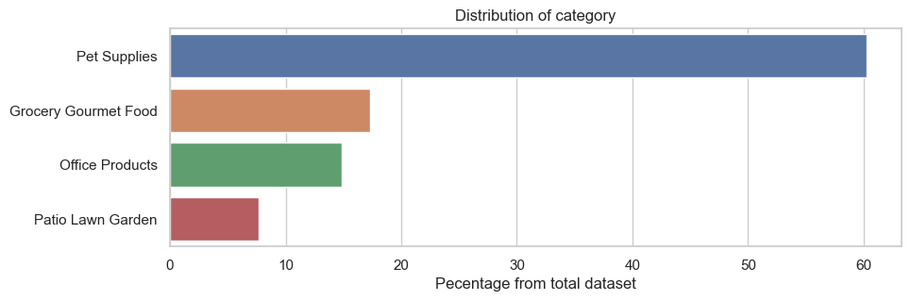
EDA
Category Distribution – Pet Supplies with more than 60%

Slide 8
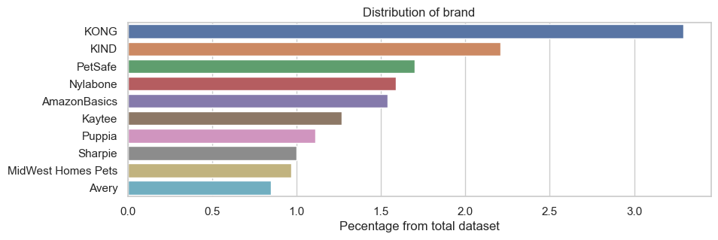
EDA
Brand Distribution – Kong and Kind are most common

Slide 9
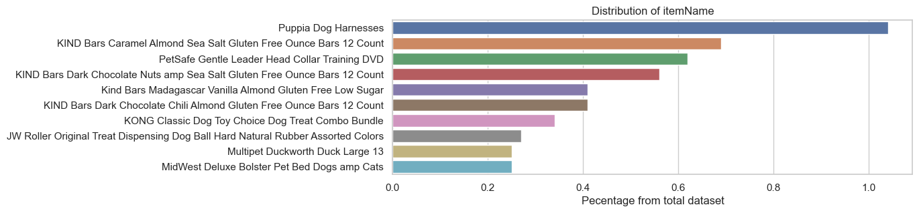
EDA
Item Distribution
Notes:
Consider talking about:
Early cultures
Classical antiquity
Medieval science
Renaissance and early modern science
Age of Enlightenment
19th century
20th century
21st century

Slide 10
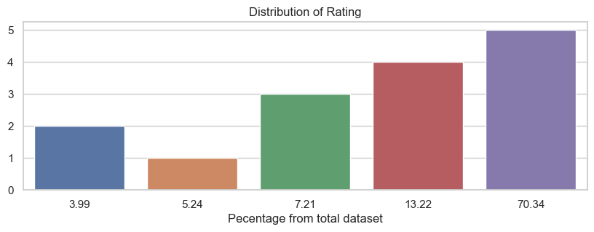
EDA
Rating Distribution – Average Rating is ~4.3

Slide 11
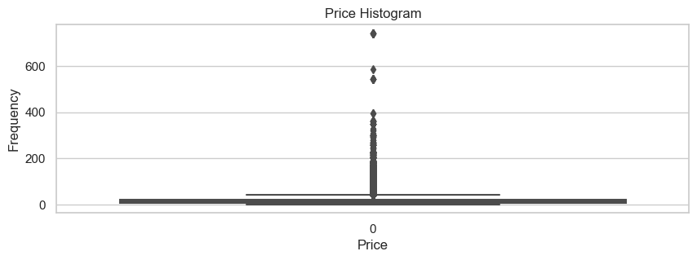
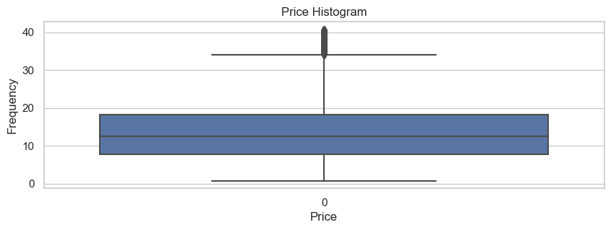
EDA
Price Box-Plot Distribution ~9K outliers , Average Price ~14$

Slide 12
Model Selection
Random
Collaborative Filtering
KNN user-based
KNN item-based
Matrix Factorization SVD
Content-Based
Cosine Similarity
Euclidean

Slide 13
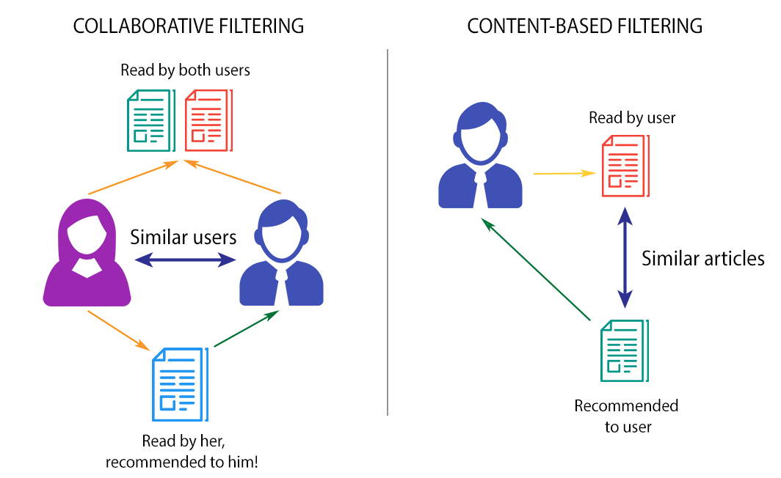
CF vs CB

Slide 14
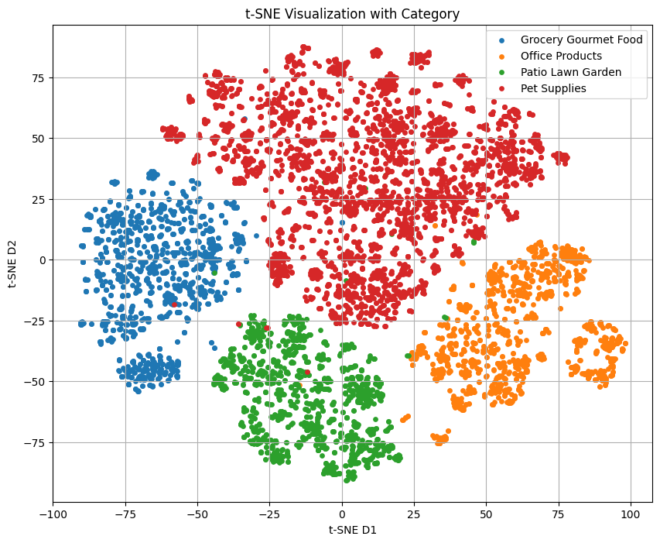
Content Based Model
Concatenate Textual Features
1
Text Embedding –Pretrained Sentence Transformer.
2
Create aggregated embed vector for each user and item.
3
Calculate Top K items for a given user (User @ Items) by Cosine or Euclidean.

Slide 15
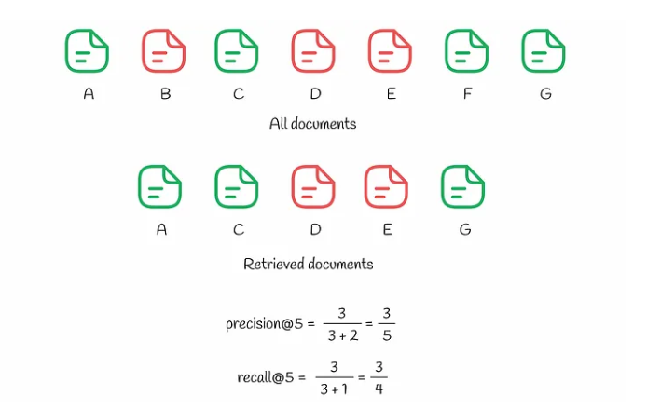
Evaluation Metrics
RMSE
recall@K (K ,Rating Threshold)
precision@K (K ,Rating Threshold)
Note - AP@K , MAP@K and more.

Slide 16
Model Comparison
 | Random | KNN Users | KNN Items | MF SVD | CB Cosine | CB Euclidean
RMSE | 1.41 | 1.18 | 1.07 | 0.95 | 1.13 | 1.57
recall@K | 0.56 | 0.78 | 0.8 | 0.79 | 0.82 | 0.05
precison@K | 0.65 | 0.76 | 0.8 | 0.79 | 0.8 | 0.07
K = 10
Rating Th = 4

Slide 17
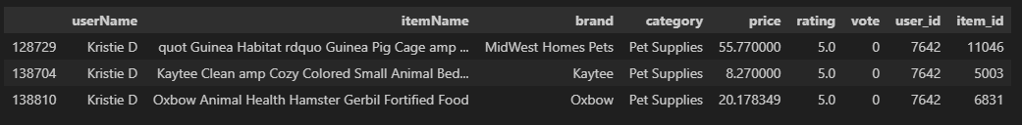
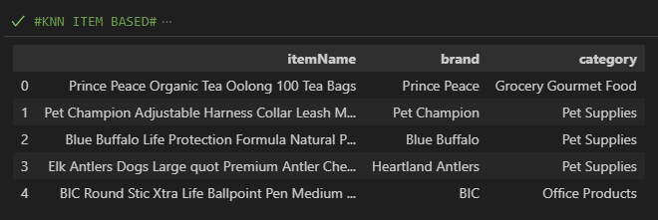
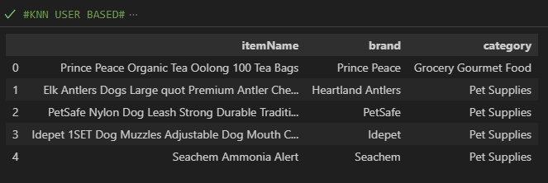
Example CF KNN

Slide 18
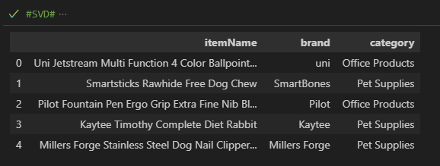
Example SVD

Slide 19
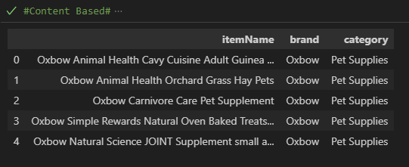
Example CB

Slide 20
Conclusion
Exploitation vs Exploration
Cosine Similarity VS Euclidean
RMSE vs @K metric
Future Work
CF and CB Hybrid
RBM
FM
DSSTNE

